Slide 1
Azure security & management
BRK2021
Name
Microsoft

Slide 2


Key customer trends
Modernization
Driving new management & security needs
Application modernization to improve ROI is in full swing
Scale
Increased cloud adoption is driving the need to better organize and govern
Security
The cloud is now perceived as an asset in fighting evolving threats
Transformation
IT is transforming to play a more strategic role

Slide 3
IT is transforming
Adopting new cloud technologies
Developers
API
ARM
Templates
Scripting
Functions
Event Grid
IT
Ops
Business
DevOps
Changing operating model
Security
Developer Collaboration
Business value
Time to market

Slide 4


Azure Security & Management
Built-in Azure services options to keep your Azure and hybrid resources secure and well-managed
Governance
NEW
Security
Resiliency
Monitoring
Automate
Proactively apply policies and optimize cloud spend
Industry leading Security with Advanced Threat Protection
High availability and protection for VMs, apps and data
Deep operational insights with rich intelligence
Powerful scripting, configuration and update management

Slide 5
Governance in Azure

Slide 6

Traditional approach needs rethinking
Speed versus control
Development
IT Governance
Speed
Control
Self-service
Production access
Rapid releases
Policies
Security
Cost Mgmt

Slide 7


Built-in modern governance
Speed and control
Management Groups
Blueprints
Cost Management
Templates
Development
Cloud Custodian
Speed
RBAC
Control
Resource
Graph
Policies
Mgmt as code
Agile Development
Policies
Security
Cost Control
Policies
Azure Governance

Slide 8
Key Azure governance technologies
"policyRule": {
"if": {
"not": {
"field": "location",
"in": "[parameters('listOfAllowedLocations')]"
}
},
"then": {
"effect": "Deny"
}
}
Resources
RBAC
Policies
Policy
Blueprints
Management groups
Enforce or audit rules to ensure compliance.
Quickly create multiple subscriptions with resources, policies and users already setup.
Map your organizational structure into Azure to enable governance in multi-tenant and cross-regional scenarios
Azure Resource Manager + Azure Resource Graph

Slide 9

Enforce policies as part of the development process
Shift left to deliver compliant code faster
Pre-flight
Code
Build/Test
Deploy
Operate
Validation
Policy as Code
Authoring
Monitoring
Security
Policy
Azure DevOps

Slide 10
Enforce policies as part of the development process
Shift left to deliver compliant code faster
Pre-flight
Code
Build/Test
Validation
Deploy
Operate
Policy as Code
Authoring
Policy
Security
Monitoring
Azure DevOps
Azure Policy

Slide 11

Demo Governance

Slide 12
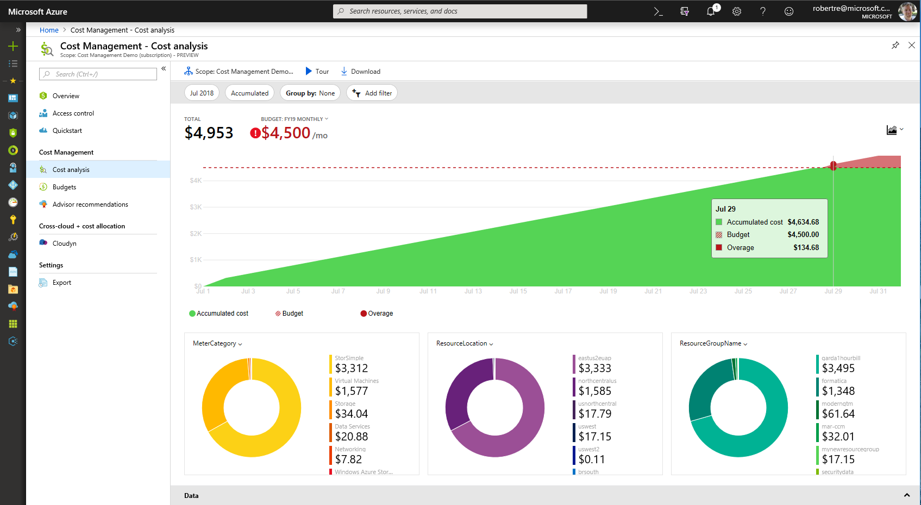
What’s New in Azure Cost Management
NEW!
Now available in preview on Azure portal for EA customers
Native within Azure Portal, on by default with improved experience
Monitor cloud usage and spend in a single, unified view
Extend cost management to PowerBI or to your custom applications

Slide 13
Securing your Azure and hybrid resources

Slide 14
Unique Intelligence
Gain Unmatched security
Controls
Identity & Access
Applications & Data
Network
Threat Protection
Security Management
Built-in
Partner
$1B+ annual investments
Over 3500 security experts
Trillions of diverse signals
Secure Foundation
Datacenter
Infrastructure
Operations

Slide 15

Simplify security management with Azure services
1
1
Identity & access management
Data protection
Network security
Threat protection
Security management
Azure Active Directory
Encryption
(Disks, Storage, SQL)
VNET, VPN, NSG
Azure Security Center
Multi-Factor
Authentication
Azure Key Vault
Application Gateway
(WAF), Azure Firewall
Microsoft Antimalware
for Azure
Azure Log Analytics
Role Based Access Control
Confidential
Computing
DDoS Protection
Standard
Azure Active Directory
(Identity Protection)
ExpressRoute
+ Partner Solutions

Slide 16
Azure Firewall
GA
L3-L7 Connectivity Policies
Cloud native stateful Firewall as a Service
Built-in High Availability and Auto Scale
Network and Application traffic filtering
Centralized policy across VNets and Subscriptions
Complete VNET protection
Filter Outbound, Inbound, Spoke-Spoke & Hybrid Connections traffic (VPN and ExpressRoute)
Centralized logging
Archive logs to a storage account, stream events to your Event Hub, or send them to Log Analytics or SIEM
Spoke 1
NAT, Network and Application traffic filtering rules allows Inbound/Outbound access
Central
VNet
Spoke2
Spoke VNets
Azure to On-Prem traffic filtering
Traffic is denied by default
On-Premises

Slide 17

Demo Azure Security

Slide 18
Resiliency in Azure

Slide 19
Architecting for high availability in Azure
Industry-only
High availability SLA
Disaster recovery
VM SLA
VM SLA
VM SLA
Regions 54
99.9%
99.95%
99.99%
Region 1
Region 2
Single VM
Availability sets
Availability zones
Site Recovery & Region pairs
Protection with Premium Storage
Protection against failures within datacenters
Protection from entire datacenter failures
Protection from disaster with data residency compliance
AZs available across US, Europe and Asia… more regions coming soon

Slide 20

Demo Resiliency

Slide 21
Monitoring your applications and infrastructure

Slide 22
Azure Monitor
Full observability for your infra, app and network
Metrics
Log
Common Store
Built-in Telemetry
Data Driven Insights
Partner Integration
A common platform for all metrics, logs and other monitoring telemetry
Advanced querying and analytics powered by machine learning capabilities
Rich ecosystem of popular DevOps, issue management, SIEM, and ITSM tools

Slide 23


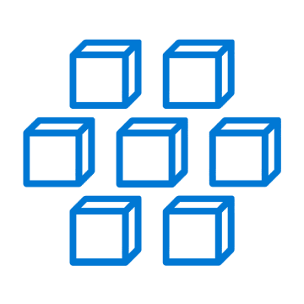
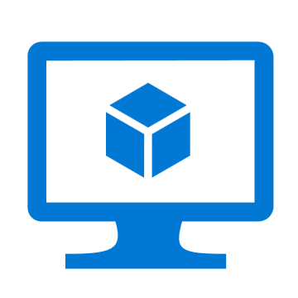
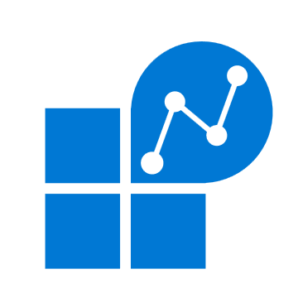









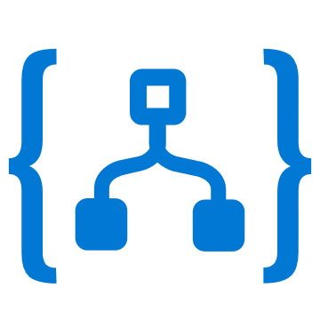

Azure Monitor
Insights
Application
Container
VM
Monitoring Solutions
Visualize
Application
Metrics
Dashboards
Views
Power BI
Workbooks
Infrastructure
Analyze
Network
Metrics Explorer
Log Analytics
Logs
Custom
Stores
Respond
Alerts
Autoscale
Integrate
Event Hubs
Logic Apps
Ingest & Export APIs

Slide 24

Demo Azure Monitor

Slide 25
Automation in Azure

Slide 26

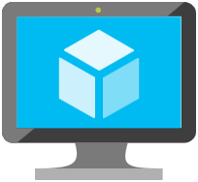
Automation
Enable consistent delivery and operations of cloud quickly and easily
Provision
Script
Orchestrate
API
Azure Resource Manager
Deliver repeatable and consistent infrastructure as code with VM extensions and resource manager templates
Azure Cloud Shell
Use PowerShell or Bash to operate your infrastructure and apps with scripts authored in languages including Python, Node.js and .NET.
Functions & Runbooks
Use functions, logic apps, runbooks and Event Grid to automate and deliver reliable and repeatable solutions.
Simplify cloud management from the command line

Slide 27

Demo Logic App

Slide 28
Call to Action
Ensure that your production resources are secure and well managed
Governance
NEW
Security
Resiliency
Monitoring
Automate
Azure
Policy & Blueprints
Azure
Security Center
Azure
Backup &
Site Recovery
Azure
Monitor
Azure
Automation
Visit: http://aka.ms/securewellmanaged

